Slide 1
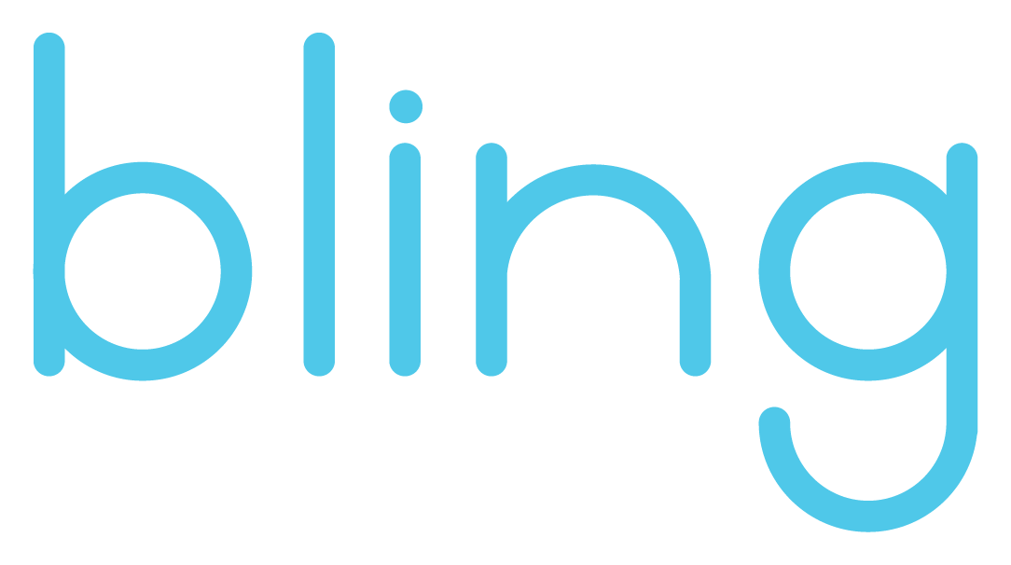
the bluetooth ring that works with you

Slide 2
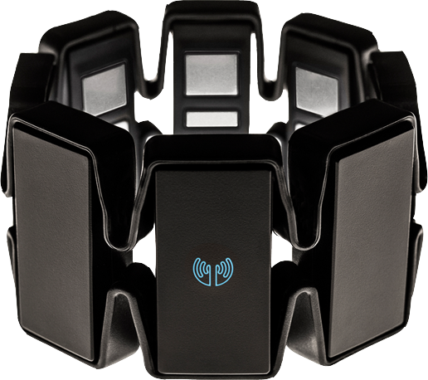
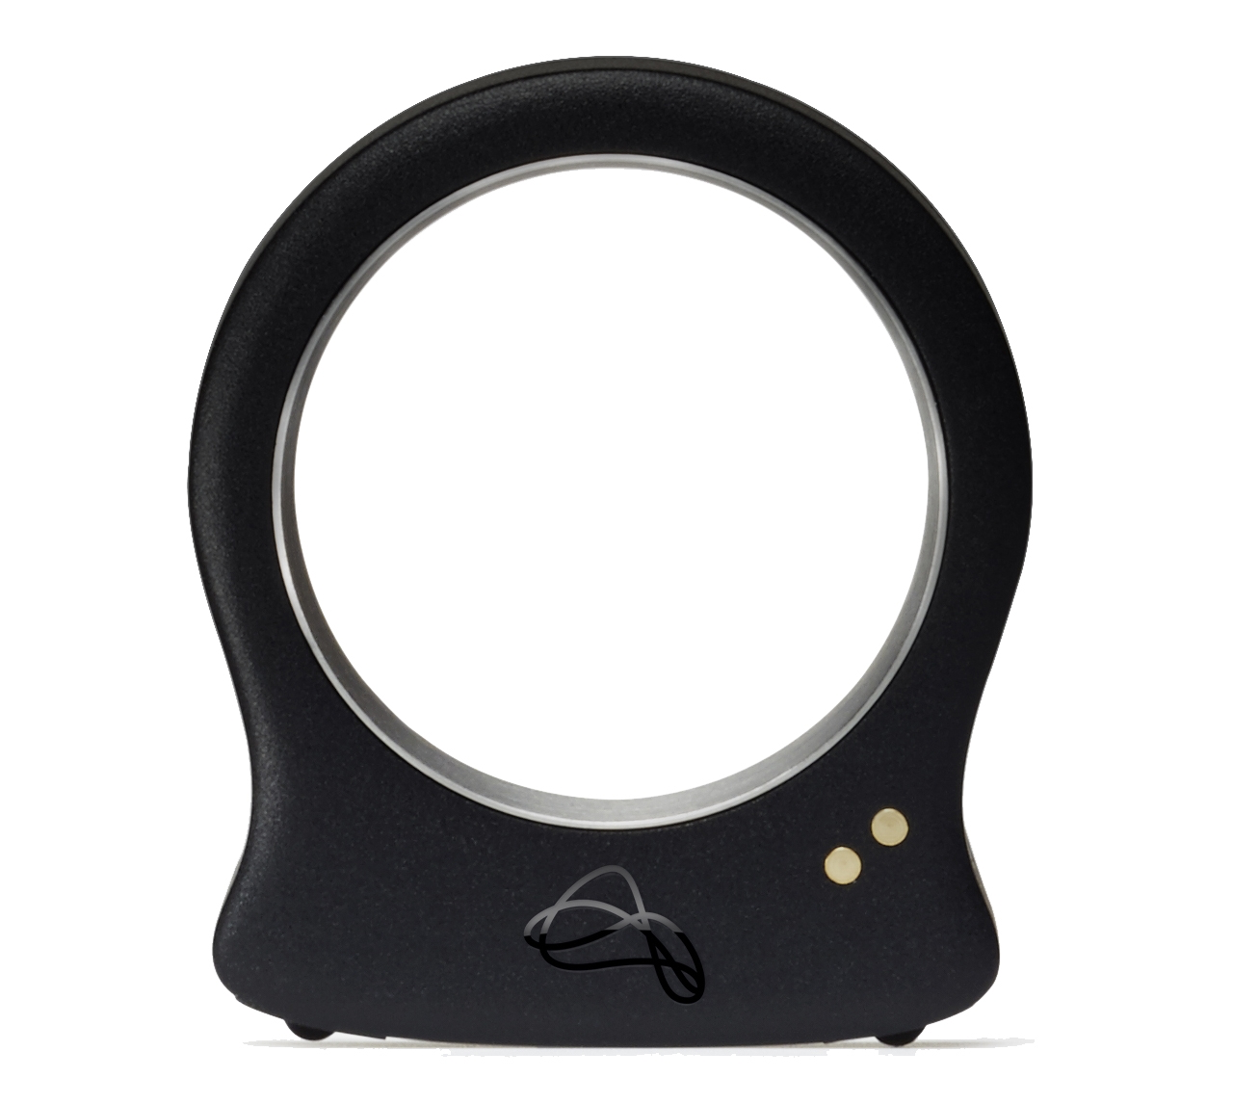
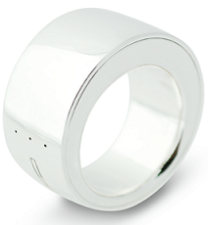
The Problem
Technology interferes with the daily life
1
Interaction with smart devices is distracting and not natural
Time between intention and action is long
Health barriers and risks exist
2
Disabled people find it hard to interact with current technologies
More than 6M US cases for Peripheral Nerve Disorders a year [1]
Current solutions are problematic
3
Very expensive
Uncomfortable to use
Gesture recognition has defects
[1] Mayo Clinic.

Slide 3
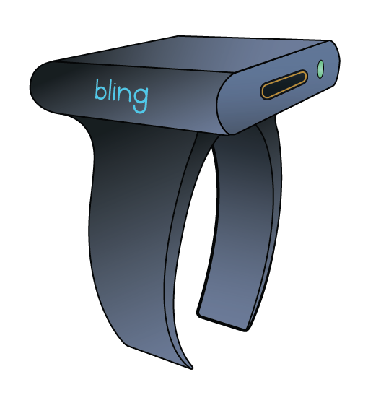
The Solution
A ring that lets you control any bluetooth
enabled device using hand gestures
Affordable, only $49
Compact and comfortable
Precise gesture recognition
Wide range of applications

Slide 4
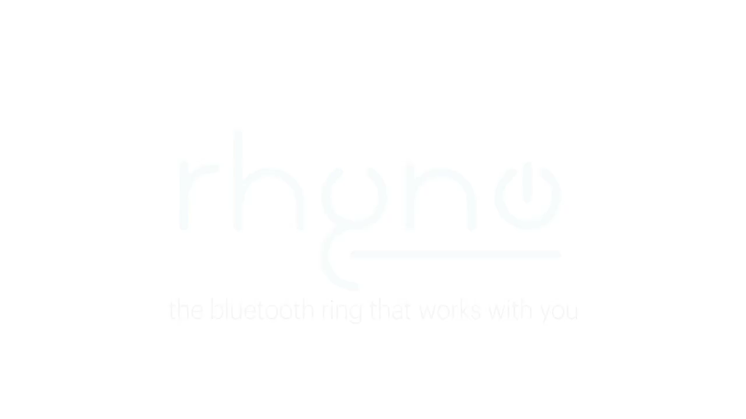
Notes:
The video goes here…

Slide 5
Market Research
Other Applications 11%
64%
Total Revenue
Smart Houses 27%
Respondents
Work / Education 21%
24%
Assistive Technologies 19%
12%
Gaming / Entertainment 22%
<$50
<$100
<$150
Price
Data obtained from a survey of 104
respondents with diverse backgrounds

Slide 6




Market Size
~15m
~20m
Smart Homes in
US and Europe
US Cases of Peripheral
Nerve Disorder
~40m
150m
Game Consoles sold globally per year
Smartphone owners in US

Slide 7
Business Strategy
$11.65
$49
2500
units
per month
0.06%
UNIT PRODUCTION COST
SALE PRICE
BREAK-EVEN SALES
REQUIRED MARKET PENETRATION
70% Materials
30% Assembly
76% Gross Margin
1st, 2nd, and
3rd Years
1st, 2nd, and 3rd Years

Slide 8


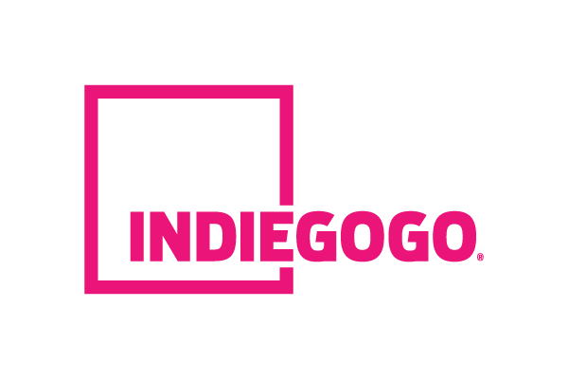
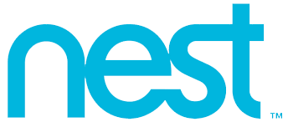
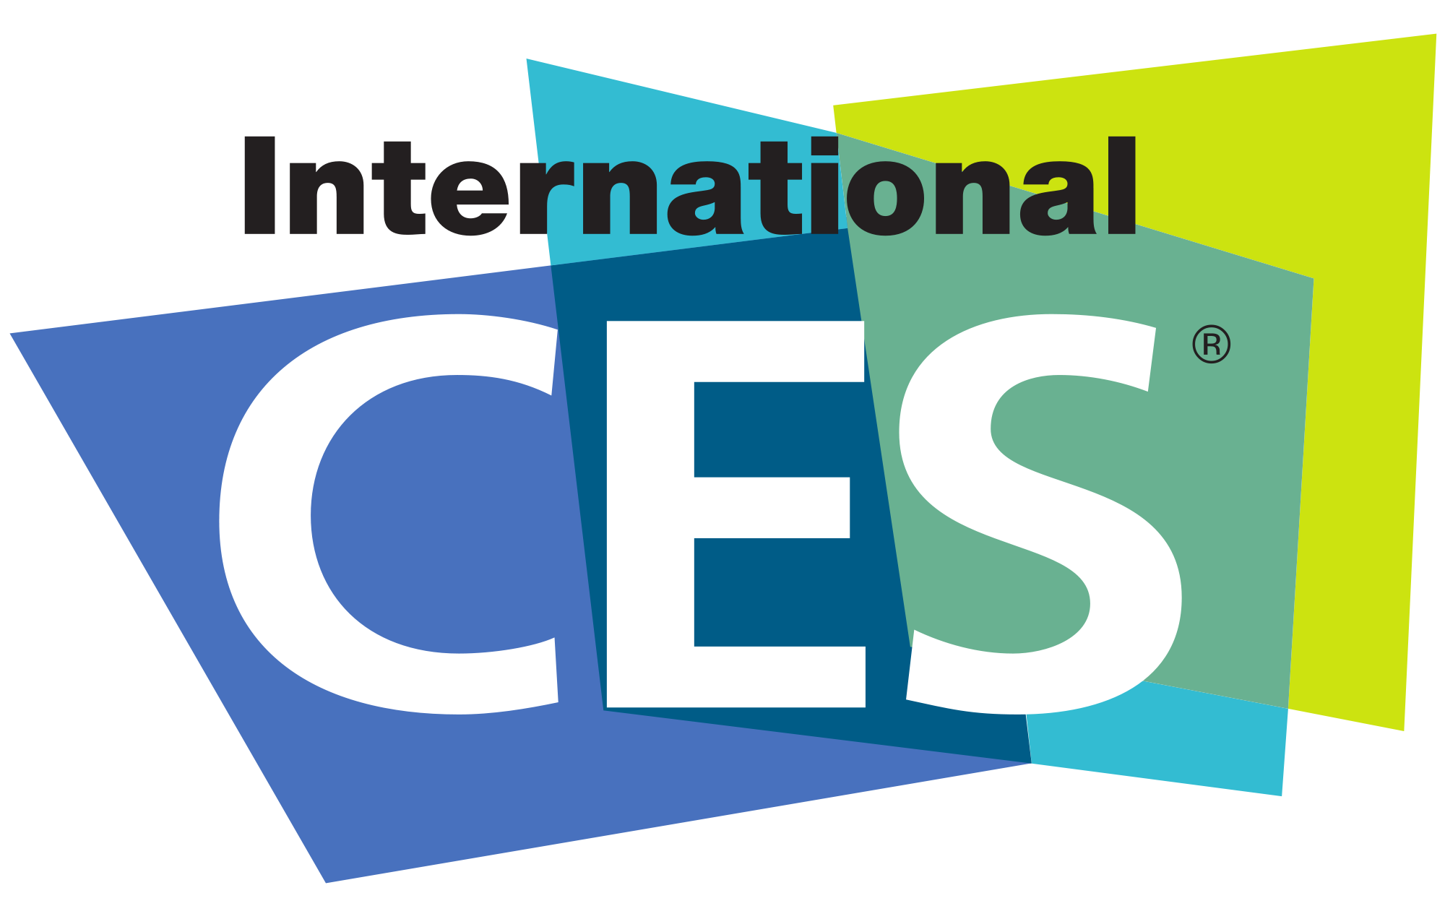

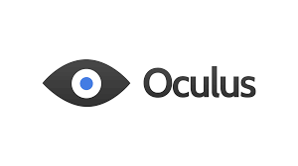
Market Adoption
Events
Partnerships
Crowdsourcing
Assistive Technology Hackathons
Gaming Conventions
Consumer Electronics Show (CES)

Slide 9
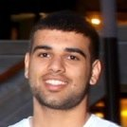
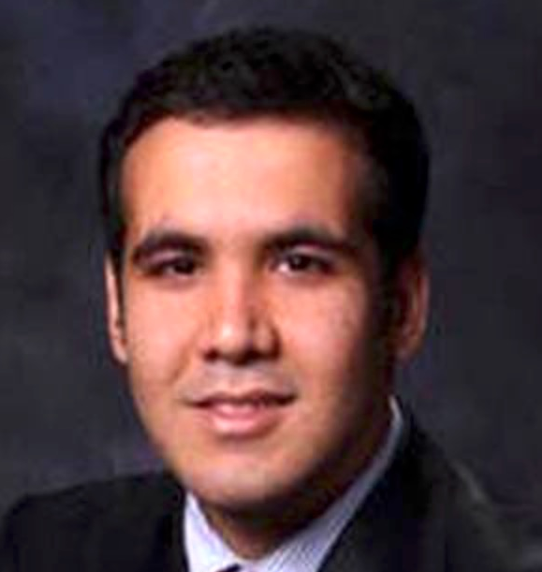

Why Us?
BIRKAN UZUN
AHMET MUSABEYOGLU
Software Engineering
MIT CSAIL, MIT Media Lab
Electrical Engineering
MIT ISN, MIT RLE
Semi-Finalist

Slide 10
The Future
WHY OUR PRODUCT?
1
Affordable
Compact and Comfortable
Precise Gesture Recognition
Wide Range of Applications
User Validated
High Margin
Patentable Design
Already Working Prototype
IMPROVEMENT IDEAS
2
NFC Implementation for Payments and Security
Addition of Touch Sensor and Voice Recognition
Alternative Energy Harvesting for Charging

Slide 11
Additional Information

Slide 12
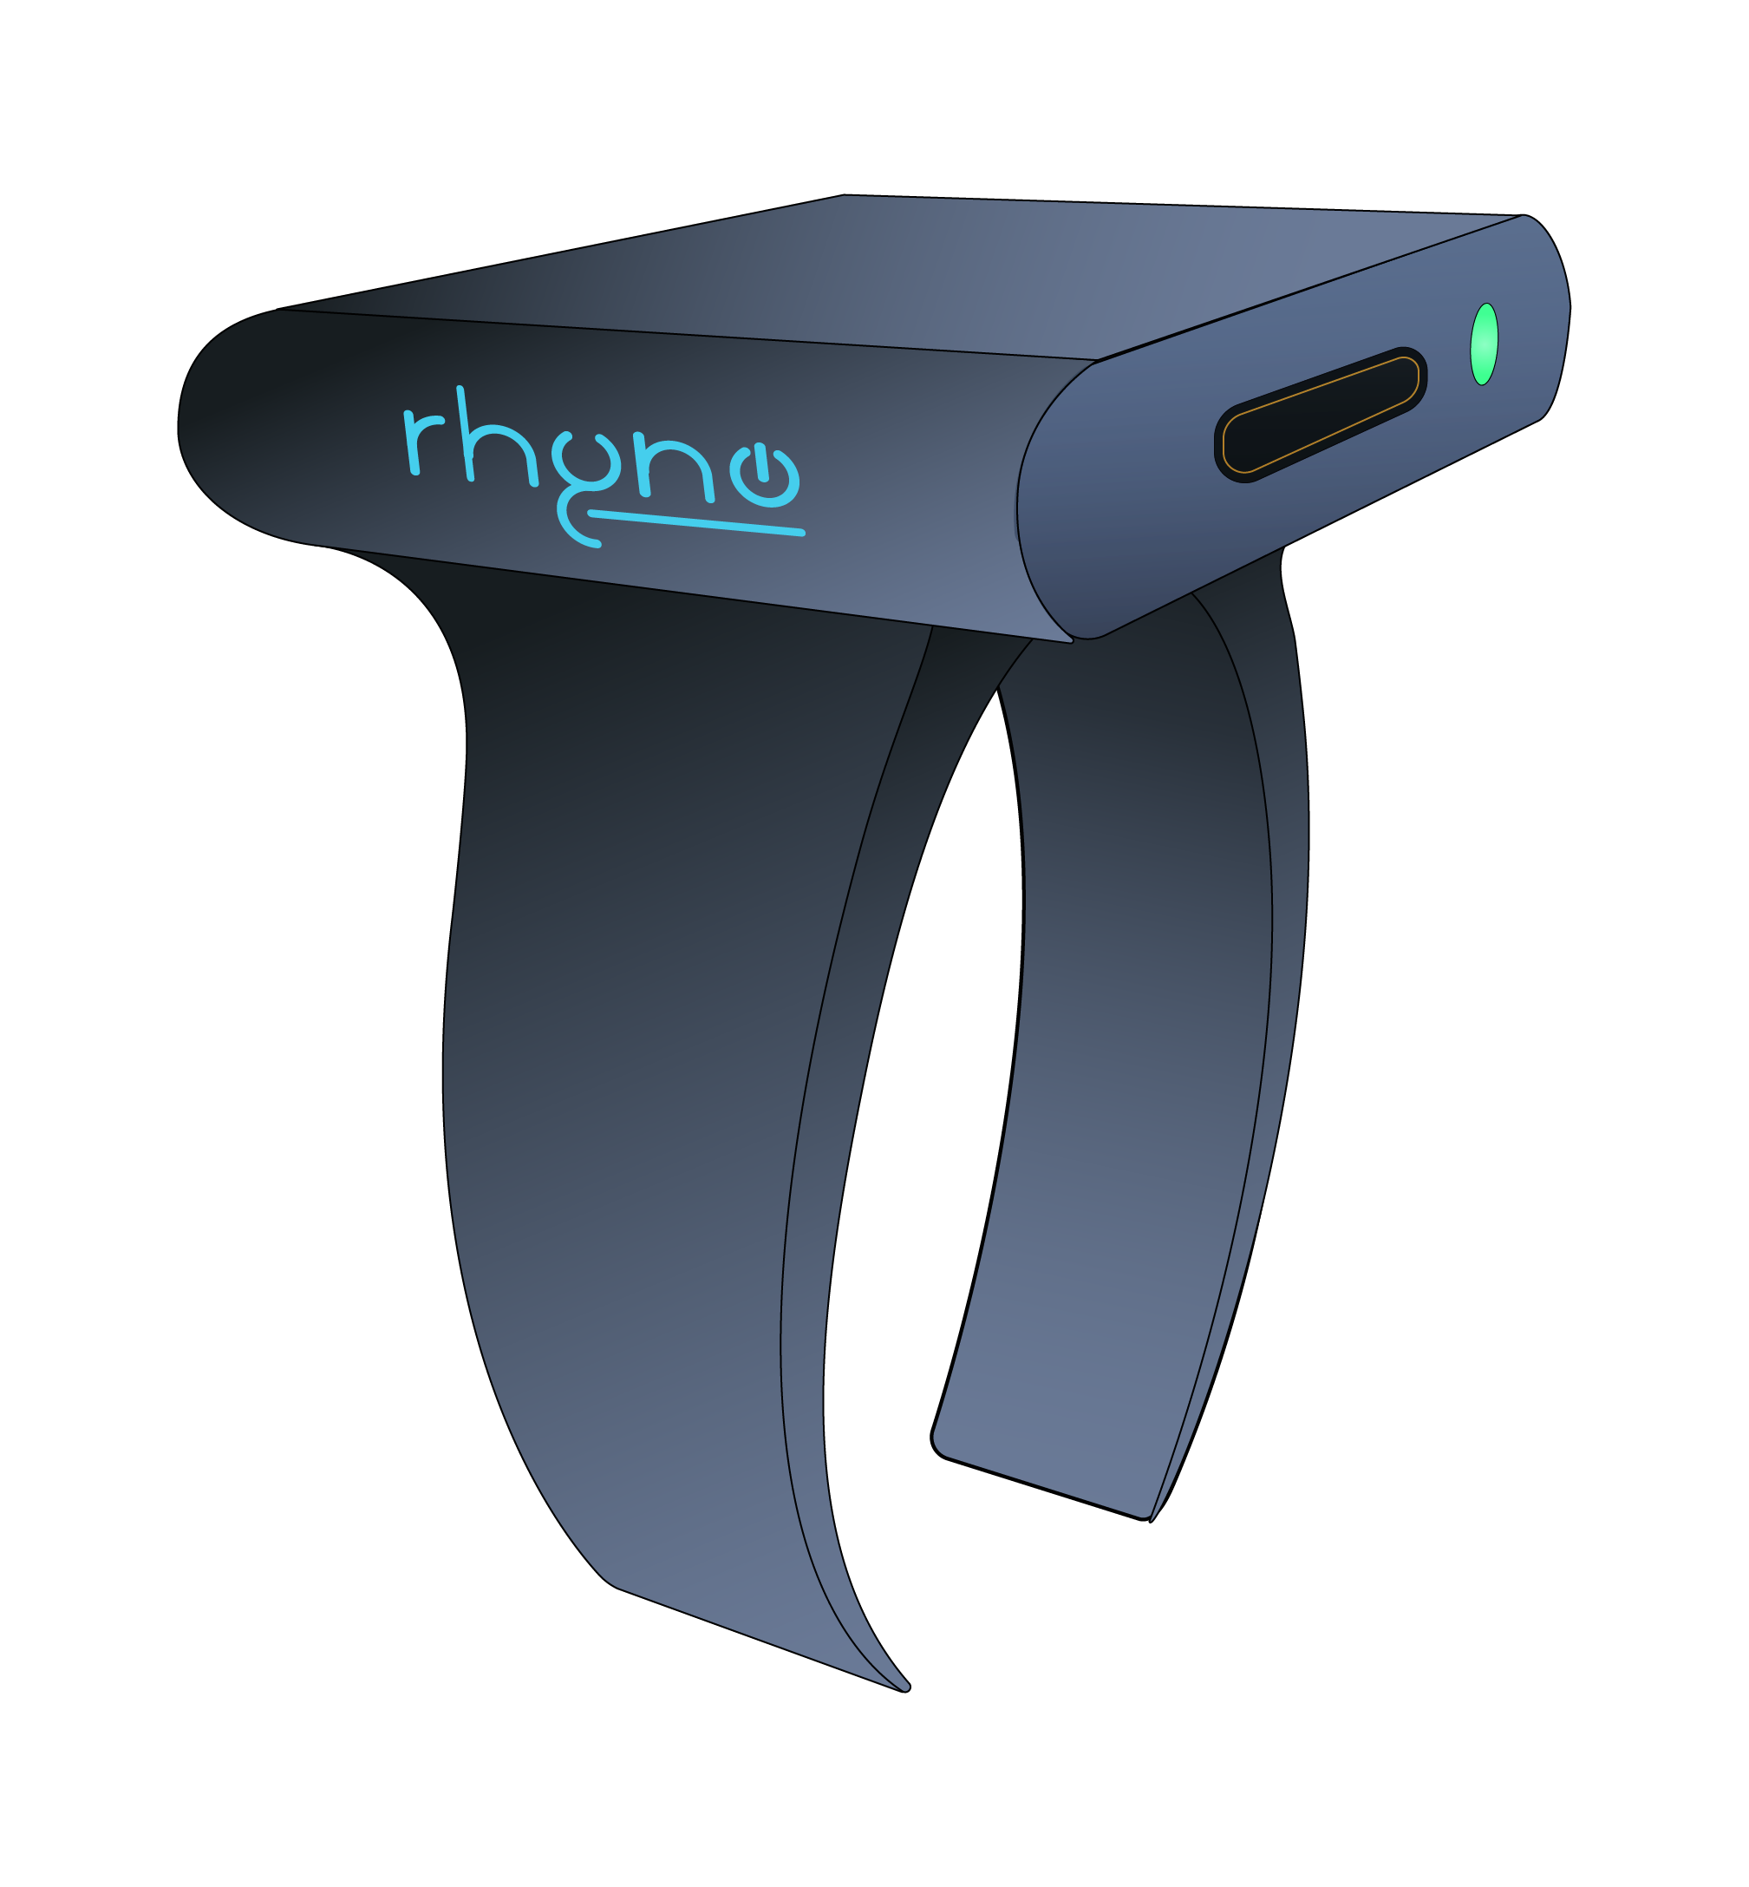
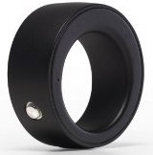
Competitive Advantages
Product | Price | Size | Battery Life | Flexibility | Charging
Bling | $49 | Compact | 9.4 Hours | ✔ | Micro USB
Logbar | $149 | Compact | 3 Hours | ✗ | Charging Dock
Nod | $149 | Compact | 6 Hours | ✗ | Charging Dock
Myo | $199 | Bulky | 6 Hours | ✔ | Micro USB

Slide 13
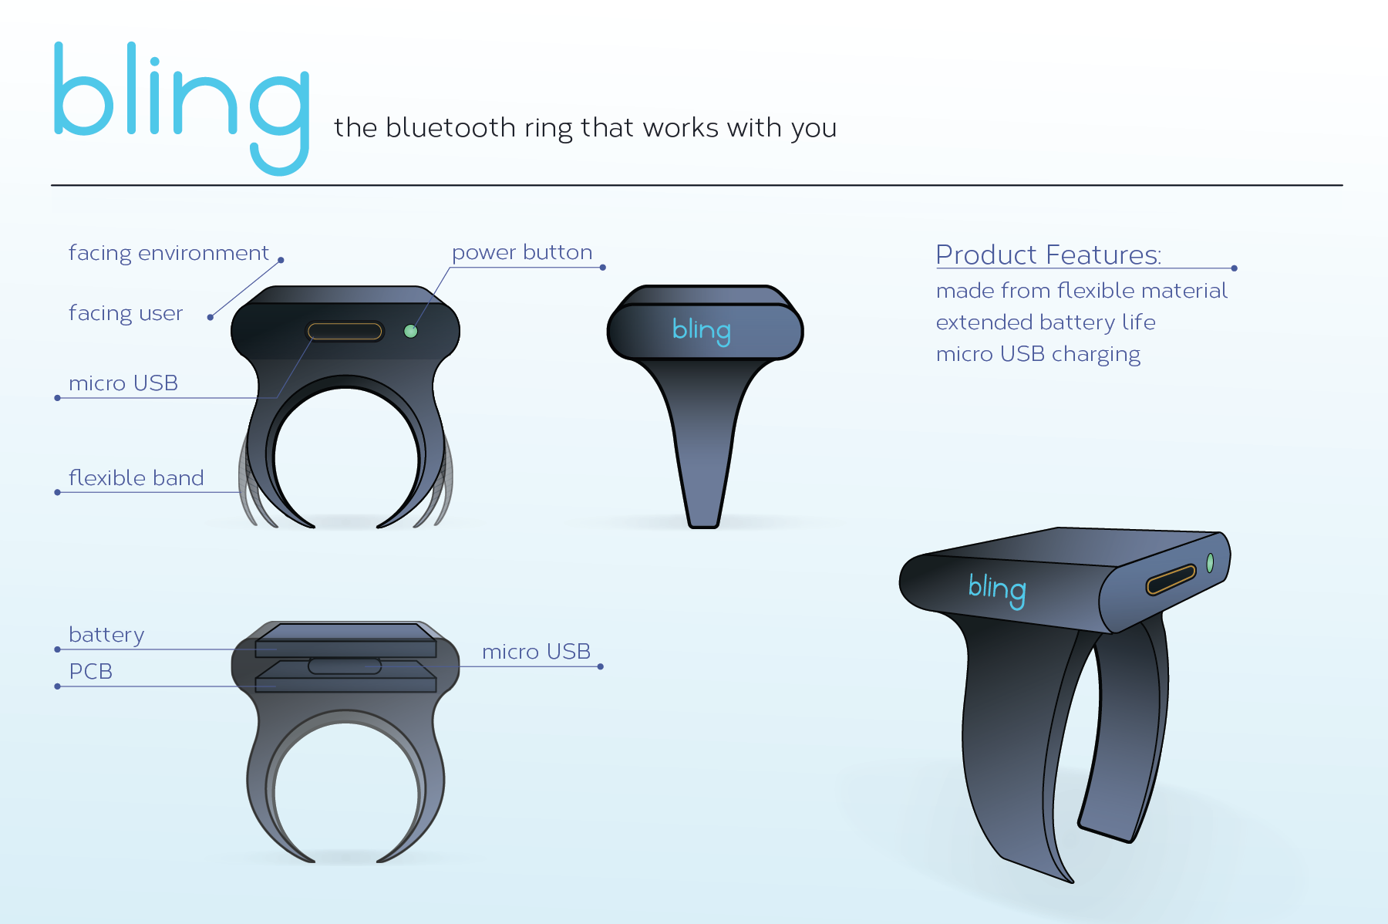
How We Make It Cheaper and Better?
How We Make It Cheaper and Better

Slide 14
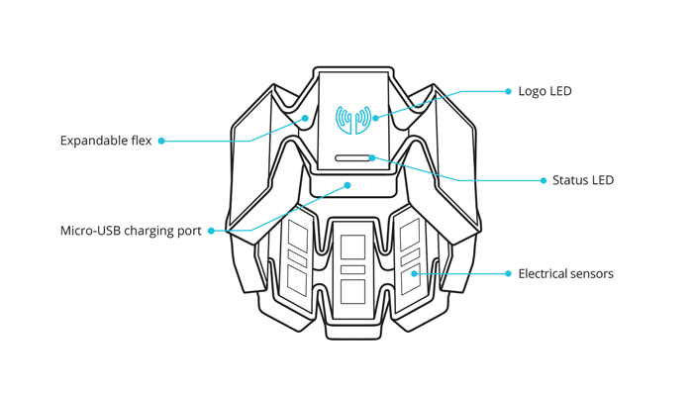
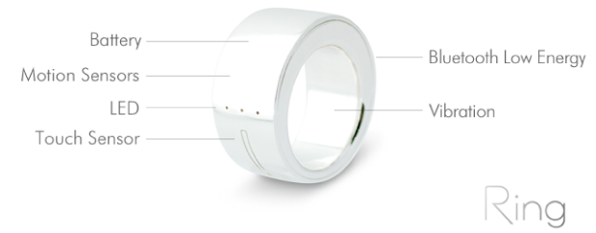
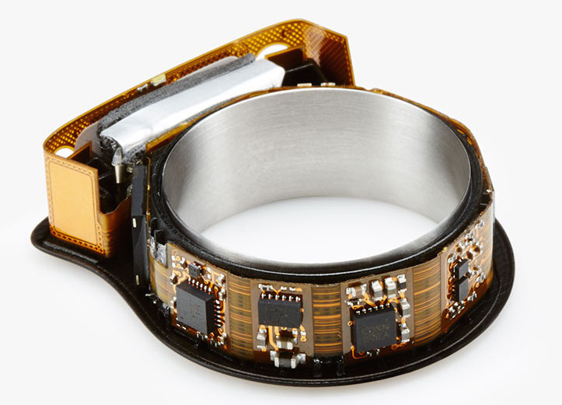
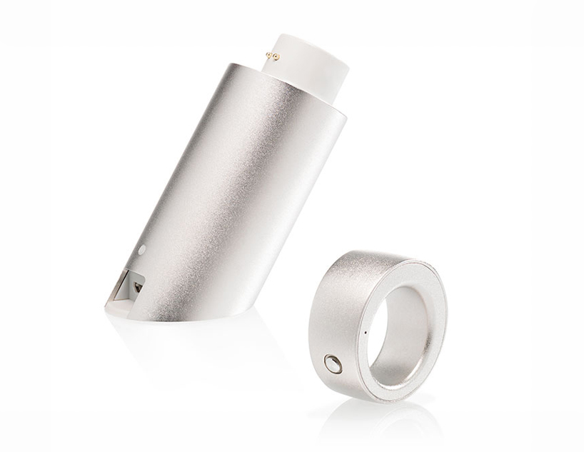
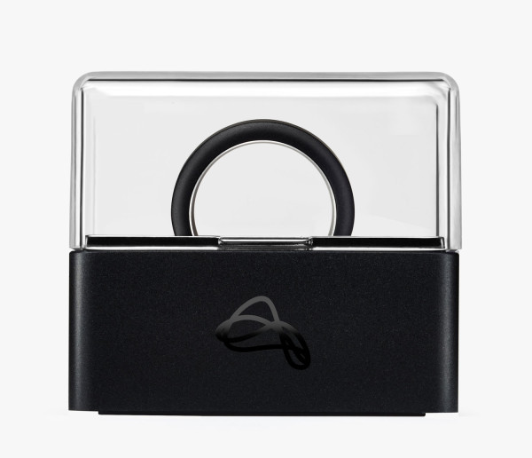
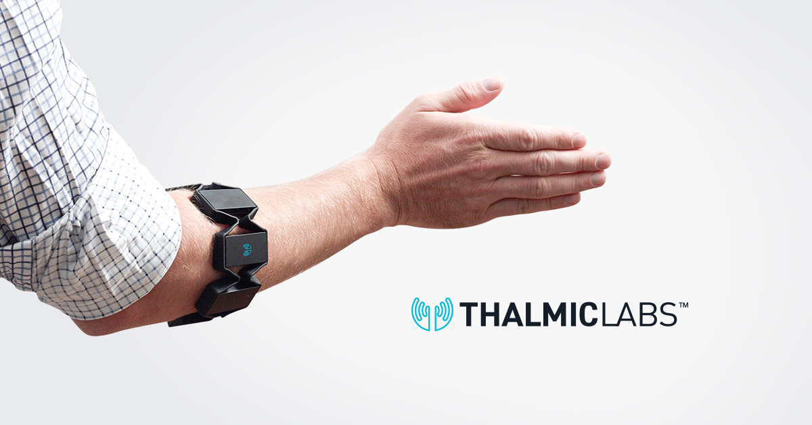
Why Our Competitors Can’t Do So?
Logbar
Nod
Myo

Slide 15
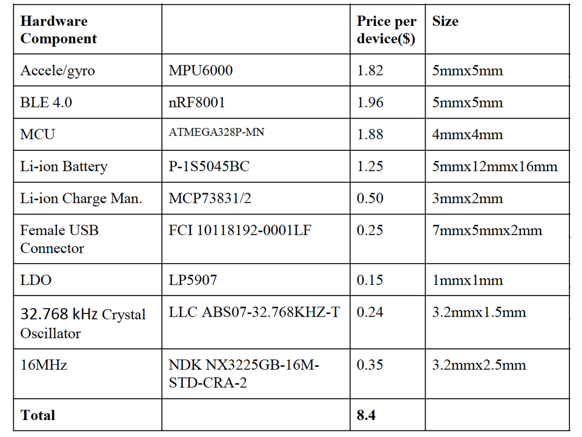
Material Cost Breakdown
This prices are valid in bulk orders over 10,000 units

Slide 16

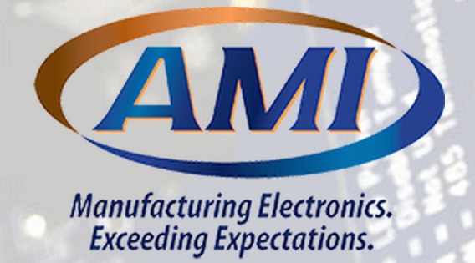

Prototype to Mass Production
Design for Manufacturing (DFM) help
Helps launching hardware Kickstarter campaings
Connects with Chinese assembly houses
In kind sponsor of MIT100K
We can get initial mass manufacturing for free
Very affordable Chinese manufacturer
$1.25 PCB assembly cost, $2 labor cost = $3.25
Can produce up to 50,000 units per year

Slide 17
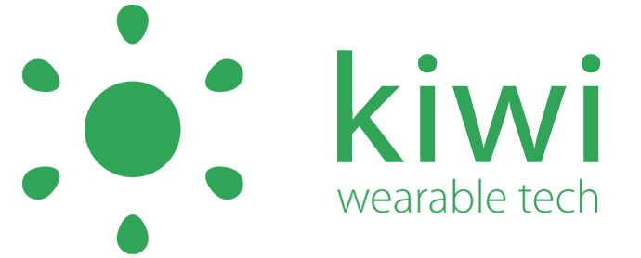
Gesture Recognition Software
Kiwi Wearable Tech which is a startup that provides a search engine for finding events in sensor data
Using their software, we can train our system so that it will be able to learn from individuals, and detect and compare gestures in real time

Slide 18
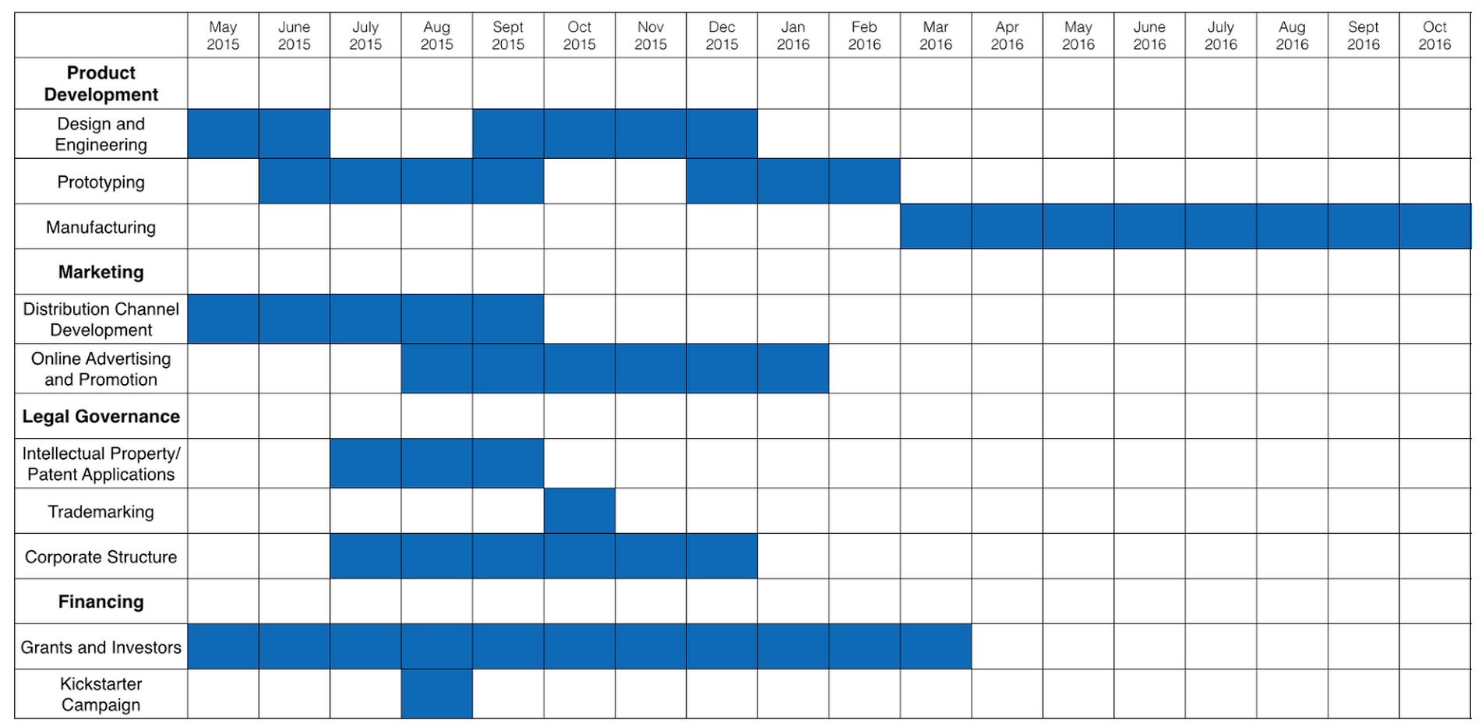
Project Milestones

Slide 19
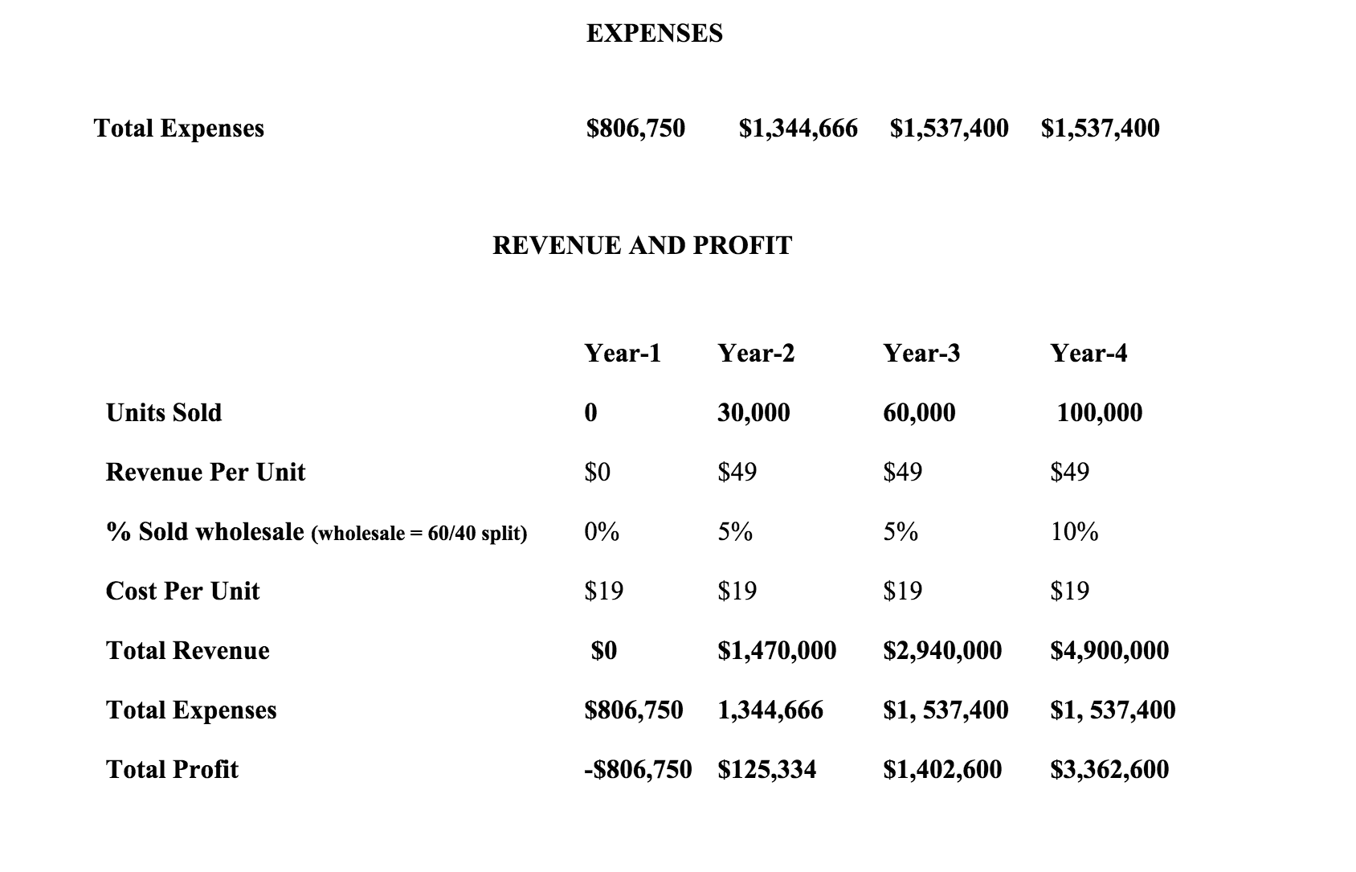
How to Break-even in 3 Years
Break-even during
3rd year

Slide 20
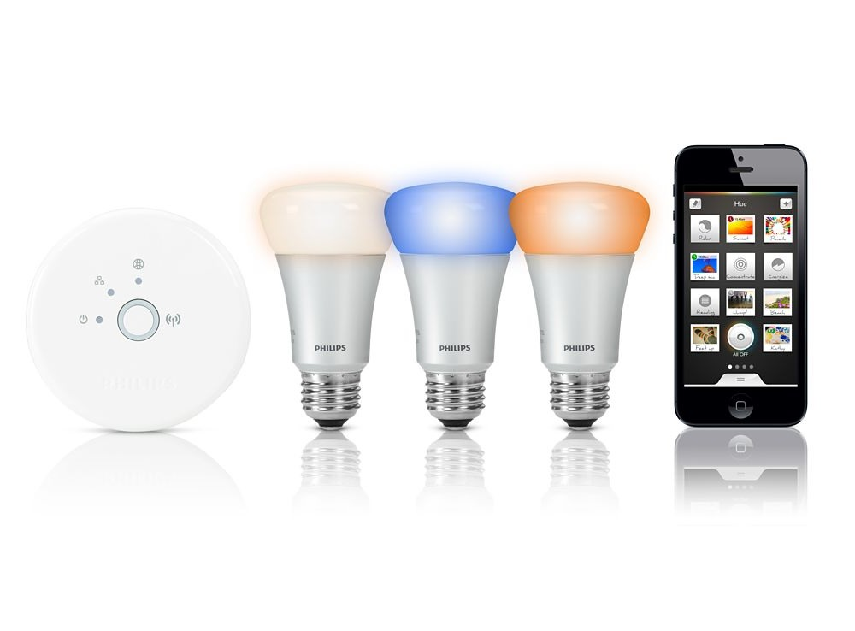
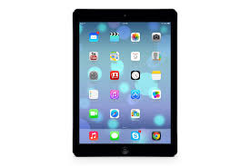
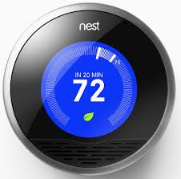
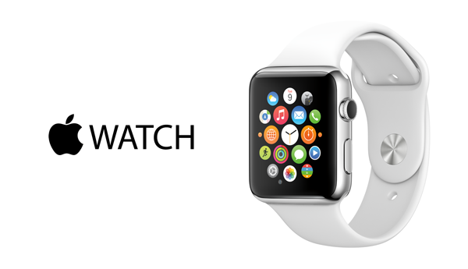
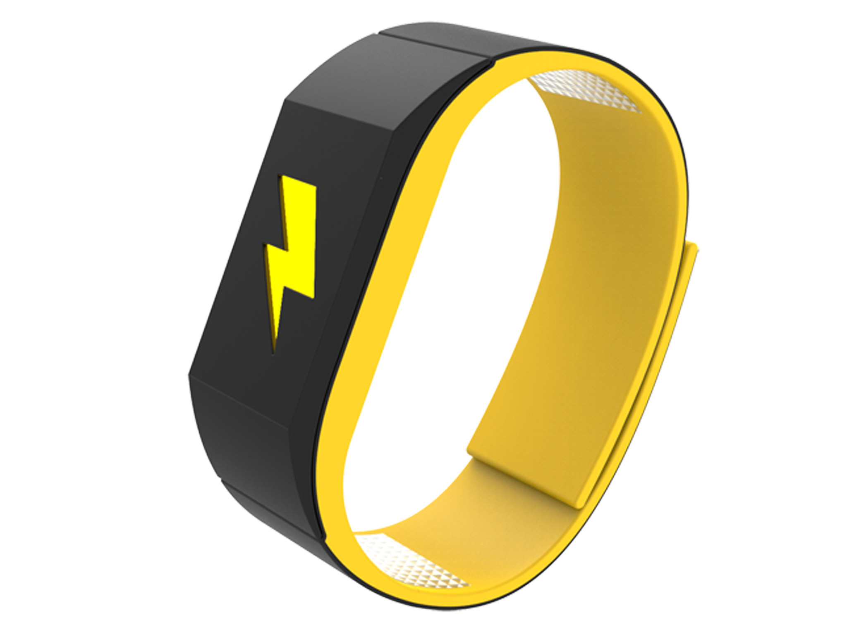
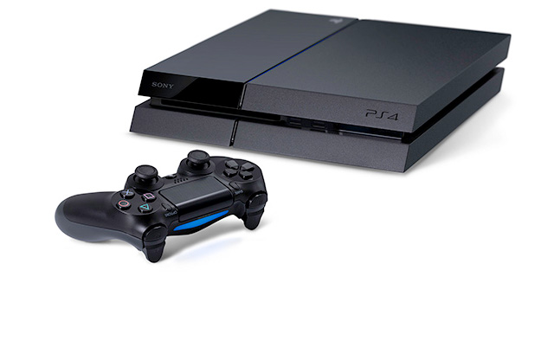
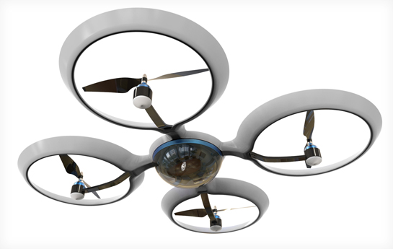
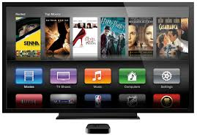
Some Compatible Products

Slide 21
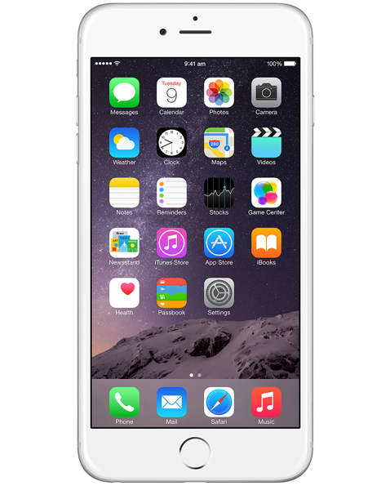
A Different Approach To Market Size
Estimated 32 million
smartwatch + smartphone
US owners
by the end of 2016
Assuming this is a reasonable market for wearable devices, we need %0.3 market penetration
for breaking even in 3 years

Slide 22
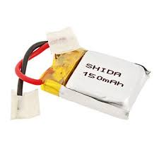
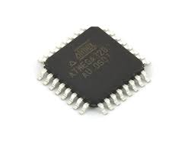
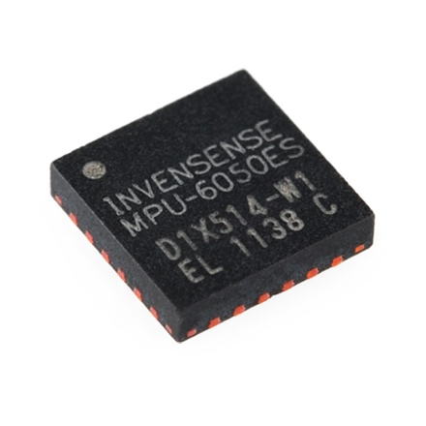
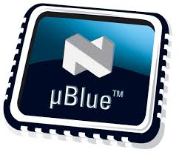
Battery Life Calculation for Bling
MPU6050
nRF8001
Atmega-328P
150 mAh Li-ion
1 mA
+
14 mA
+
1 mA
→
150 mAh
(150 mAh/16 mA) = 9.4 hours

Slide 23
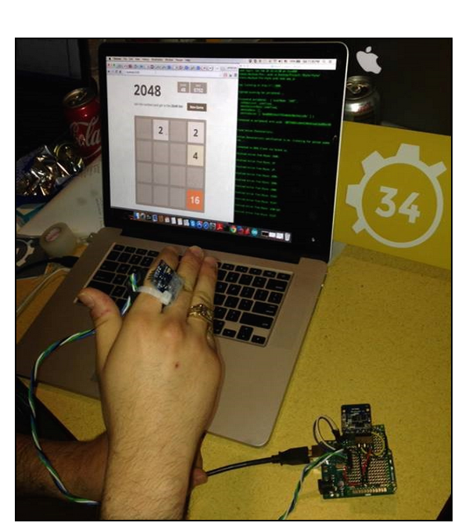
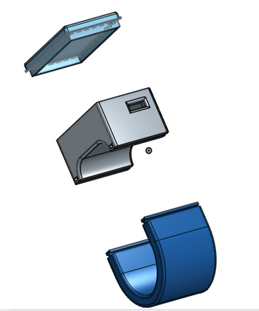
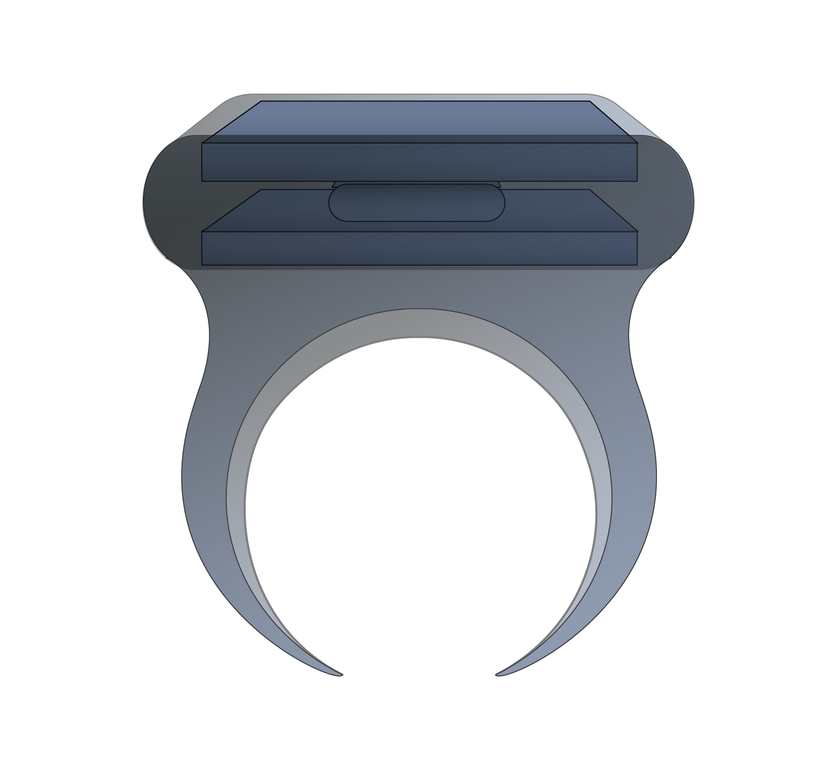
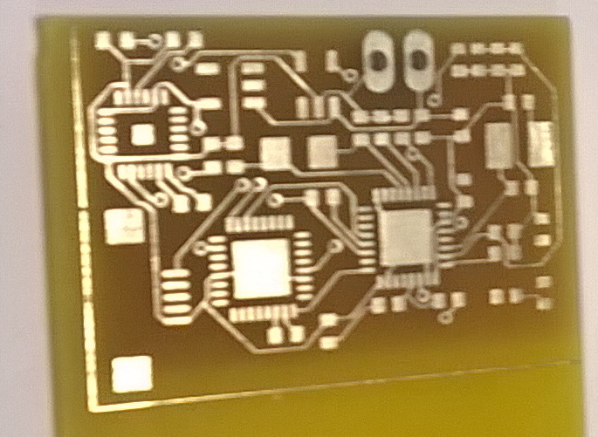
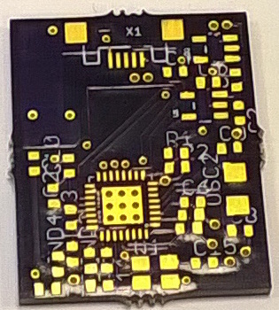
Prototyping Steps
First Prototype
Second Prototype
Current Prototype

